Slide 1


Relay Assisted Pliable Index Coding
Project Group number: 13 Domain: Communications Guide name: Prof. Bivas Bhattacharya
Name | USN
Kushaal R | 1PE17EC068
Praneeth Kashyap | 1PE17EC089
Pushkar Pramod Wani | 1PE17EC093
Sagar Raj N | 1PE17EC112

Slide 2
Problem Description
We consider binary multiway relaying problem with nodes having pliable demands and present algorithms to reduce the total number of transmissions compared to naïve transmissions.
Demands are said to be pliable when every node is satisfied with decoding/obtaining any message it does not have, but is present with other nodes. Relays are used in scenarios where direct communication is not possible.
Multiway relaying problem consists of exchanging messages amongst multiple nodes via a relay. We consider the case where every node has a set of messages known as its side information.
We consider coding at the network layer with only two nodes transmitting at a time. The relay receives the XOR of bits transmitted by the two nodes and broadcasts the same. Our goal is to minimize the total number of transmissions such that each node receives at least one message it does not have apriori.

Slide 3
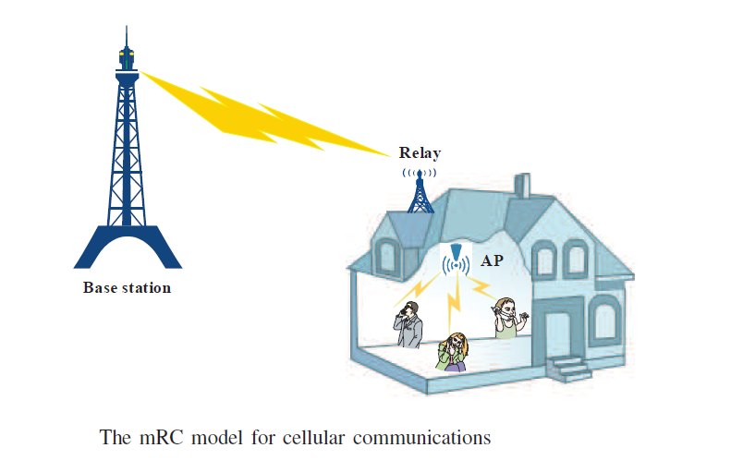
Relays and their uses
Range extension using multiple relays.
Functionality extension using relays.

Slide 4
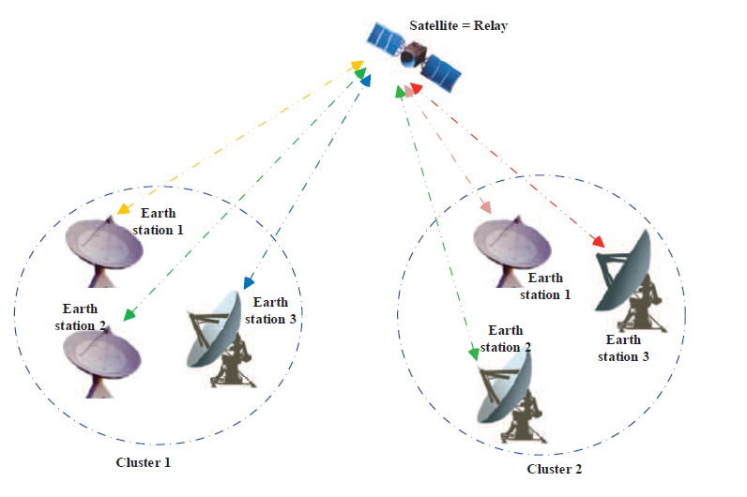
What is Multiway Relaying?
Multiuser communication channel
Uses a relay terminal in half duplex mode
Multiple users communicate concurrently

Slide 5
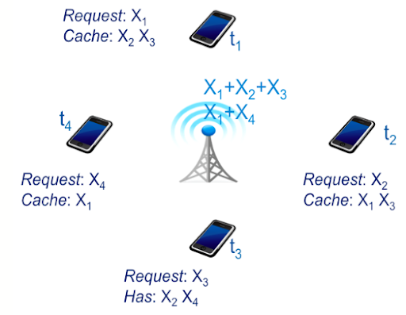
What is Pliable Index Coding?
Index Coding:
Request - want set of the node
Cache – has set of the node

Slide 6
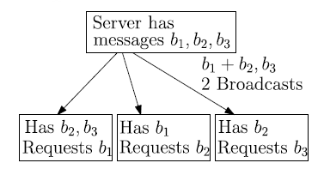
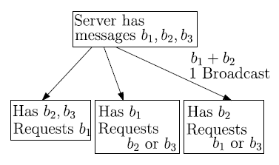
Pliable Index Coding (contd.)
A variant of Index Coding.
Clients’ demands are pliable.
Taking advantage of side information reduces number of transmissions.

Slide 7
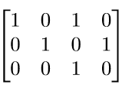
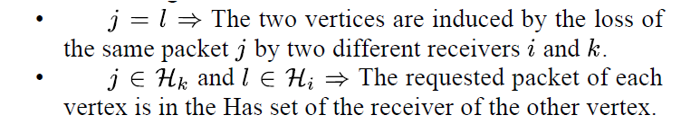
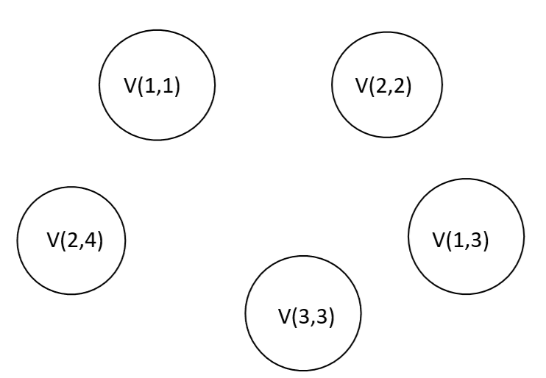
Side information matrix and IDNC graphs
Side information matrix
Conditions for generating an IDNC graph and an adjacency matrix from side information matrix:
b₁ b₂ b₃ b₄
c₁
c₂
c₃

Slide 8
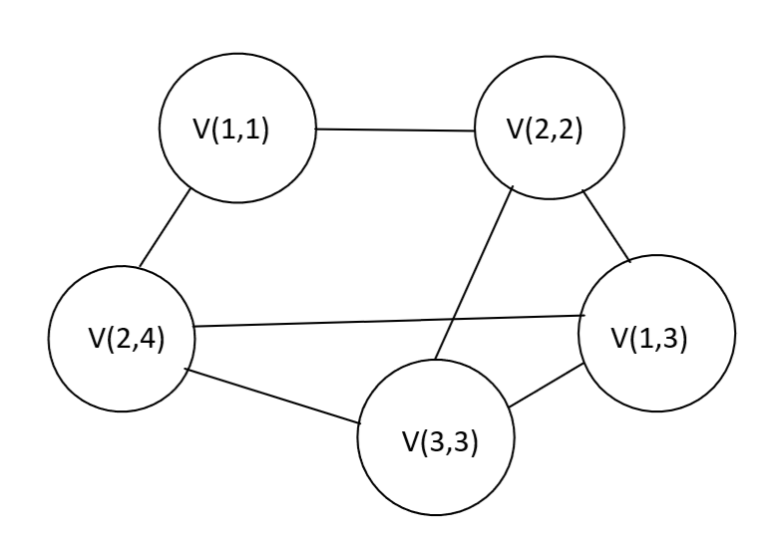
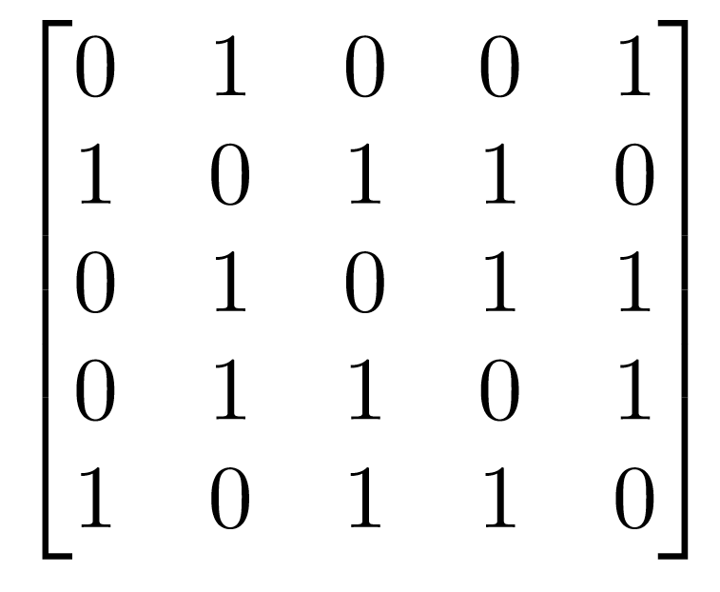
Generating an adjacency matrix from an IDNC graph
(1,1)
(2,2)
(1,3)
(3,3)
(2,4)
(1,1)
(2,2)
(1,3)
(3,3)
(2,4)

Slide 9
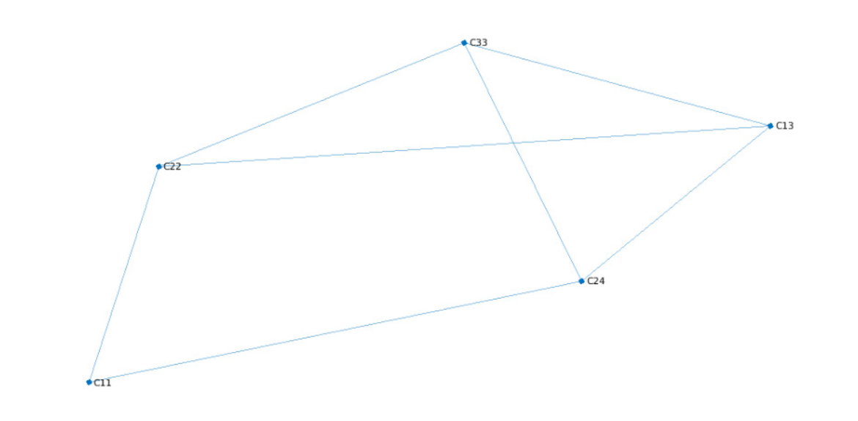
Matlab Output for IDNC graph

Slide 10
Relay and Assumptions
Relay is used to connect multiple users who are not directly connected in the network
Relay is no long term memory and thus store no messages or message packets
We work at the network layer since this is the lowest layer that gives access to the packets without dealing with flow control, error control and frame synchronisation. This allows us to directly model the flow of data in terms of packets and rapidly simulate and analyse the performance of the network.
Additionally this analysis can be translated to firmware quickly since routers and WiFi access points primarily work at the network layer. We assume that the overhead caused by node feedback after each phase is not greater than the overhead caused by conventional index coding.

Slide 11
Multi-way relay network structure

Slide 12
What are phases?
A phase consists of one or more nodes transmitting to the relay, and the relay broadcasting the decoded data to all the nodes
We implement FCU (Fixed Channel Use) scheme which consists of 2 parts:
Part 1: constitutes 1 phase
Part 2: consists of floor(N/2) phase
We repeat these parts until the PICOD(t) condition is satisfied

Slide 13
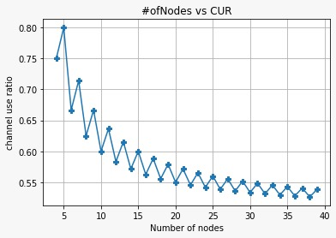
Simulation Results
This particular simulation result demonstrates the extensibility of the 1bit MWR scheme (implemented in reference paper) to n-bit packets

Slide 14
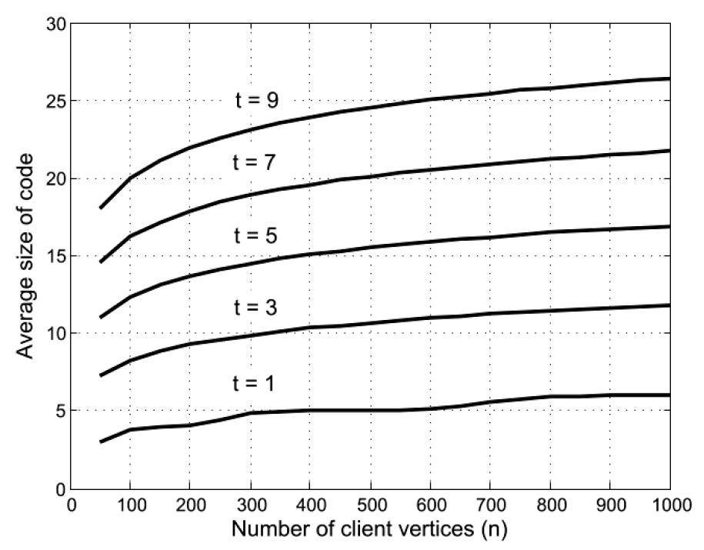
PICOD with random side information
Algorithm mentioned in PICOD paper

Slide 15
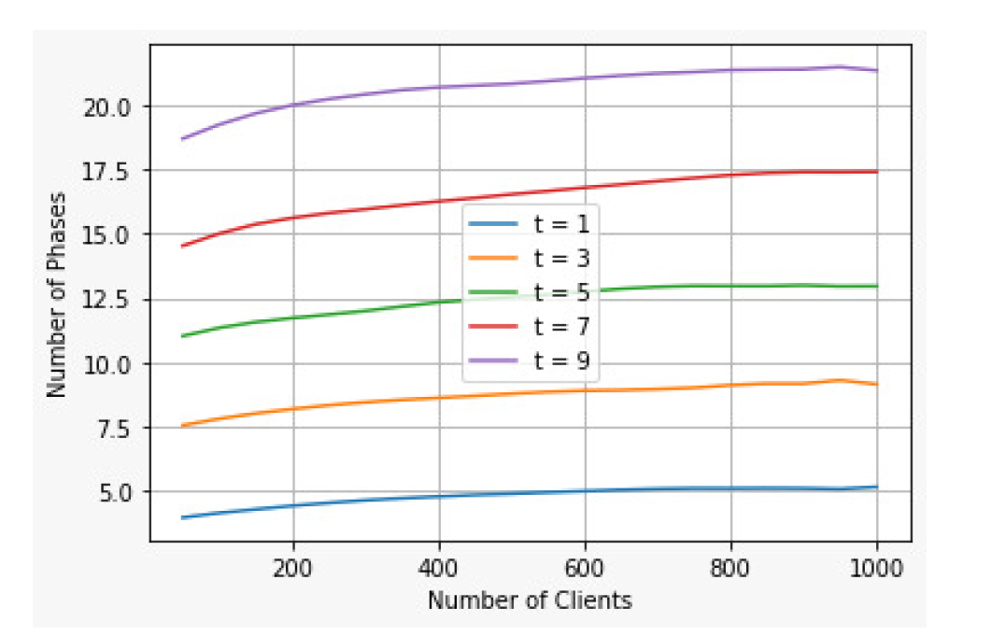
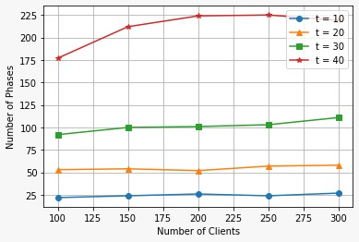
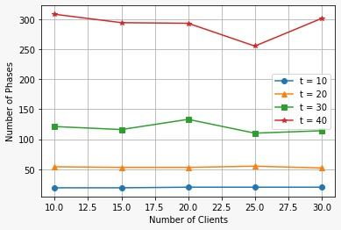
PICOD with random side information
Previous simulation results of PICOD imposed MWR network
Simulation results of PICOD imposed on MWR network

Slide 16
Future Scope
• To evaluate the efficiency of an algorithm and to substantiate the obtained results, asymptotic analysis can be performed using mathematical derivations and statistical analysis.
• The concept of combining two nodes can be extended to higher order, taking into account the resulting trade-off between bits per symbol and BER as a result of higher order combining, which results in a denser constellation.
• With an increasing number of devices connecting to the internet, particularly IoT devices, it is not feasible to add base stations to cover smaller and smaller areas, hence the concept of relaying is a better option.
• Relaying reduces the number of transmissions, thereby saving power and contributing to greener communication. Furthermore, there is no need for additional infrastructure or a redesign of existing architecture to implement the relaying concept.

Slide 17
Literature survey
A Throughput Efficient Multi-Stage Technique for Binary Multiway Relaying - Saket D. Buch, Chinmayananda Arunachala, and B. Sundar Rajan. (published August 2020)
An Overview on Multiway Relay Communications: Fundamental Issues, Recent Advances, and New Challenges - Rui Wang and Xiaojun Yuan. (published October 2020)
A Deterministic Algorithm for Pliable Index Coding - Linqi Song and Christina Fragouli (published January 2016)
Pliable Index Coding - Siddhartha Brahma and Christina Fragouli (published September 2015)

